Slide 1
Dopamine Insights
Exploring the Science and Applications of Dopamine in Human Behavior

Slide 2
Introduction
This presentation delves into the critical role of dopamine in brain function, its influence on motivation, and its applications in real-world scenarios.

Slide 3
01
Dopamine Overview

Slide 4
Definition and Function
Dopamine is a neurotransmitter that plays a key role in transmitting signals in the brain associated with pleasure, reward, and motor function. It is crucial for regulating mood, attention, and movement. In excess or deficiency, dopamine levels can lead to various neurological and psychological disorders, highlighting its importance in maintaining mental health.

Slide 5
Role in Motivation
Dopamine is often referred to as the 'feel good' neurotransmitter due to its association with pleasure and reward-seeking behavior. It motivates individuals to act toward goals, helps reinforce learning through rewards, and influences decision-making processes. Understanding its role can aid in developing strategies to enhance motivation in educational and professional settings.

Slide 6
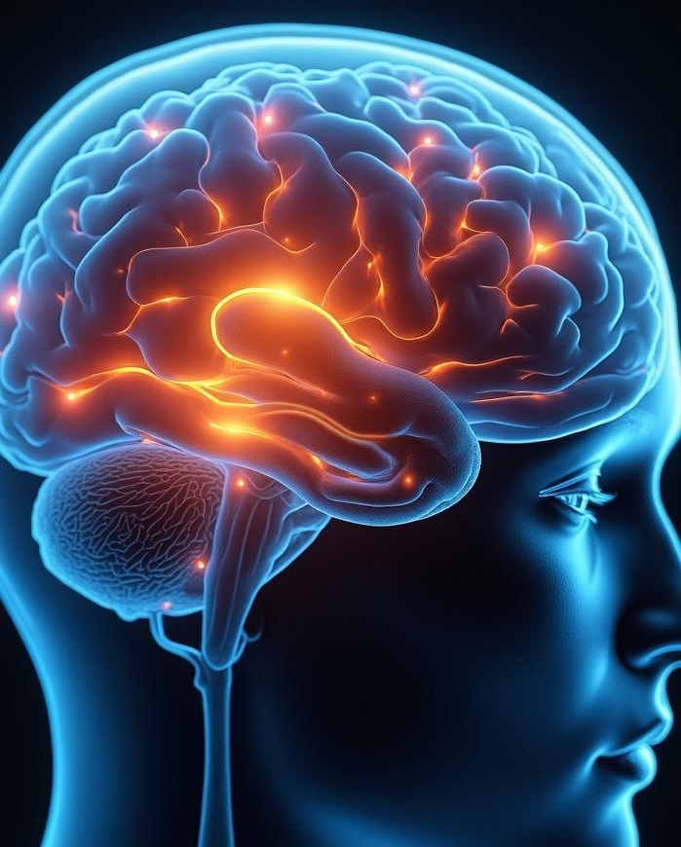
Impact on Behavior
Dopamine significantly influences behavior by affecting emotional responses, pleasure experiences, and reward-seeking actions. Variations in dopamine levels can lead to changes in behavior patterns, such as increased impulsivity or motivational drive, as seen in disorders like ADHD or addictions. Understanding dopamine's impact is essential for developing behavioral interventions and treatment options.

Slide 7
02
Applications and Solutions

Slide 8
Real-World Examples
Dopamine's role extends into various fields, including psychology, education, and health. For instance, in the realm of education, gamification utilizes reward systems to increase student engagement by stimulating dopamine release. In addiction treatment, therapies focus on restoring dopamine balance to manage cravings and improve recovery outcomes.

Slide 9
Innovative Approaches
Innovative solutions are emerging to harness dopamine's effects, such as brain stimulation therapies aimed at enhancing dopamine release for mood disorders. Additionally, technology-driven applications, like mobile health apps, are designed to track and encourage behaviors that promote healthy dopamine levels, illustrating a proactive approach to mental well-being.

Slide 10

Research Evidence
A growing body of research supports the multifaceted roles of dopamine in behavior and mental health. Studies have demonstrated the correlation between dopamine dysregulation and conditions like depression and schizophrenia. Evidence from neuroimaging techniques shows how dopamine pathways contribute to decision-making and impulse control, reinforcing the importance of this neurotransmitter.

Slide 11

Conclusions
Dopamine is a vital neurotransmitter that significantly influences motivation, behavior, and emotional well-being. Understanding its functions and applications can lead to innovative strategies in diverse fields, from education to mental health, ultimately aiding in improving personal and social outcomes.

Slide 12
Thank you!
Do you have any questions?
+91 620 421 838

